Slide 1
Stapleton, Denver Demographic Profile
May 2016
Elizabeth Garner
State Demography Office
Colorado.gov/demography

Slide 2
Geography and Data 101
State
  Counties
    Cities and Places (Highlands Ranch, Evergreen)
    Census Tracts – Optimum population size 4,000
      Block Groups – Optimum population size 1,500
        Blocks – more related to physical features
  Over time cities work to create census geographies to match neighborhood boundaries working with Census Bureau
  American Community Survey 5 year data (rolling) available for Tracts and Block Groups. Current 2010-2014.
  Group Quarter Population – Prison, jail, schools, transitional facilities.
  Denver County Jail and Women’s Facility about 3,200 is in Stapleton Geography and in population and will impact most data unless pulled out using Household Population or Non Institutionalized Pop.

Slide 3
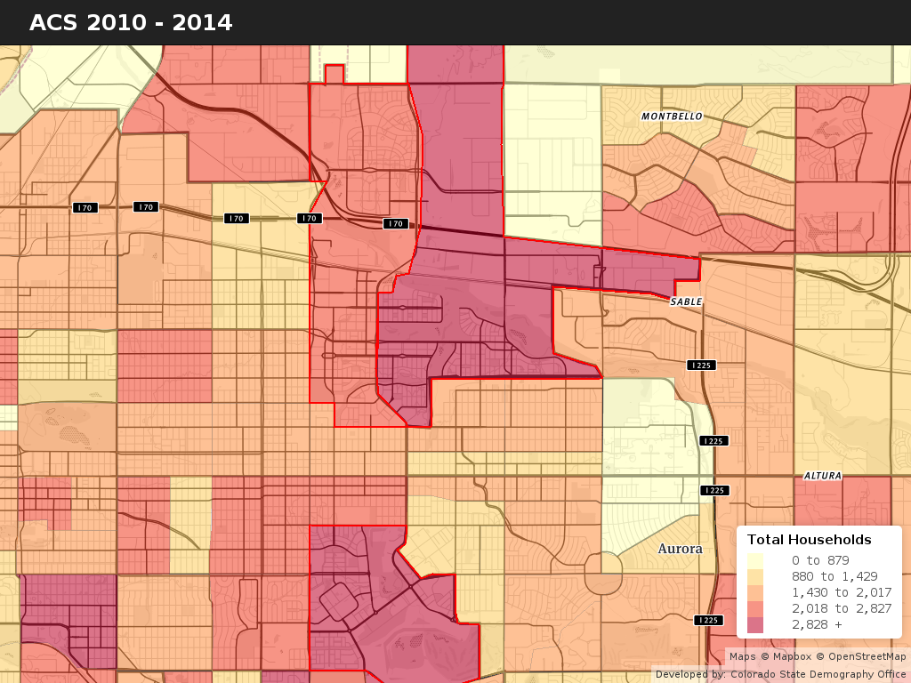


Tract 41.06
Stapleton is made of two Census Tracts 41.06 and 41.07
Next geography re-draw will be for Census 2020
Stapleton will have new data by new geographies in 2022 or 2023

Slide 4
Total Household Population
2010 Census Stapleton – 10,755
  3,810 West of CPB
  6,945 – East of CPB
2010-14 ACS – Stapleton – 13,439
  4,807 - WCPB
  8,648 – ECPB
Lowry 2010 – 7,316
Lowry 2010-14 – 8,184

Slide 5
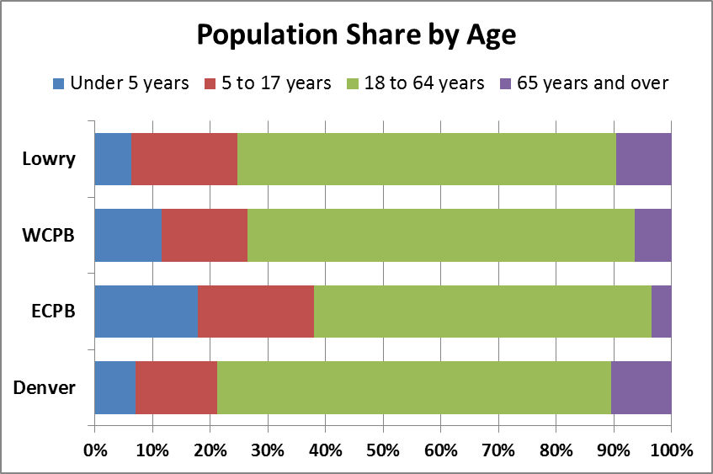
Source: ACS 2010-14

Slide 6
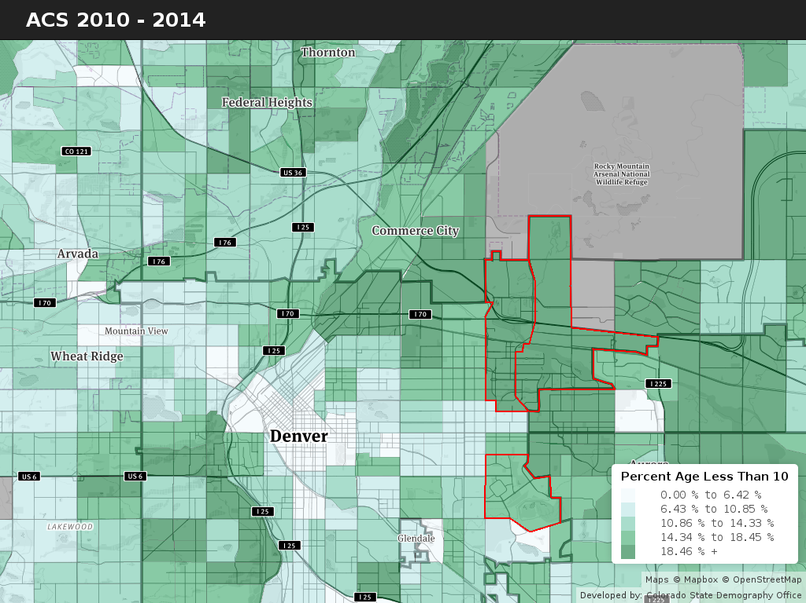

Slide 7
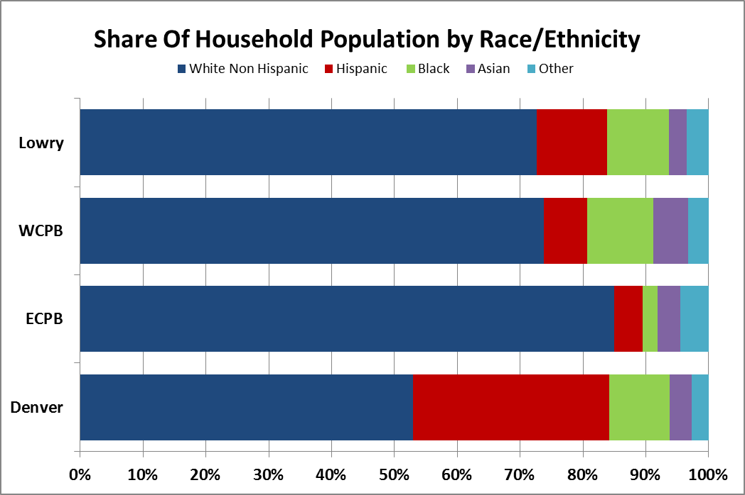
Source: ACS 2010-14

Slide 8
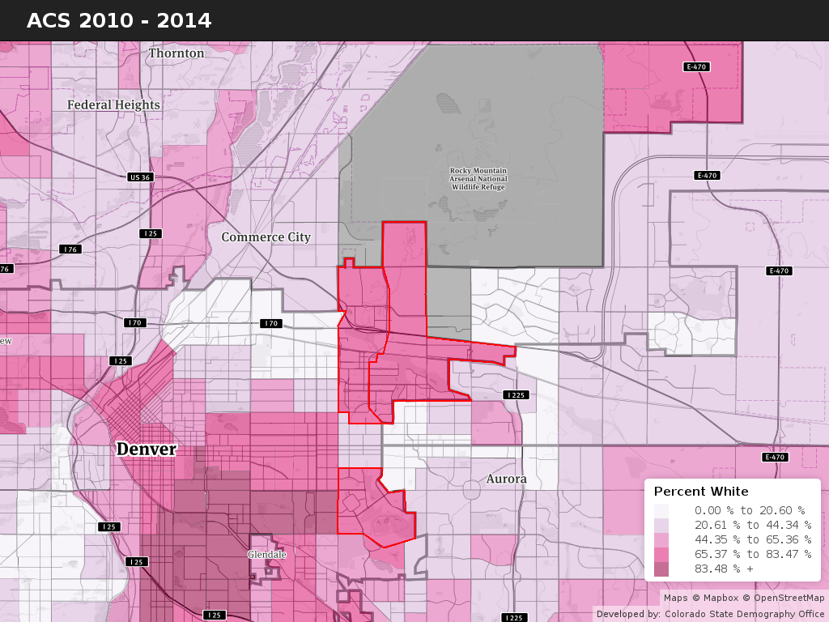

Slide 9
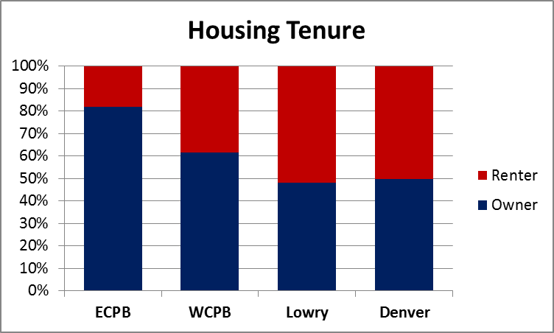
Source: ACS 2010-14

Slide 10
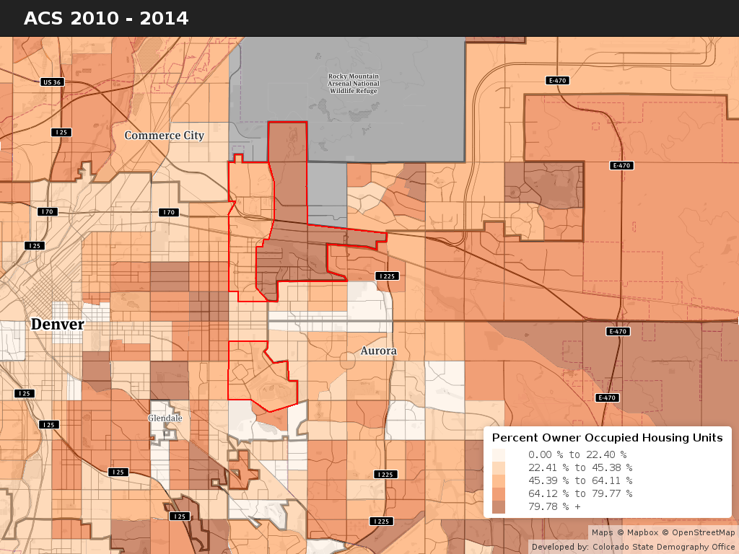

Slide 11
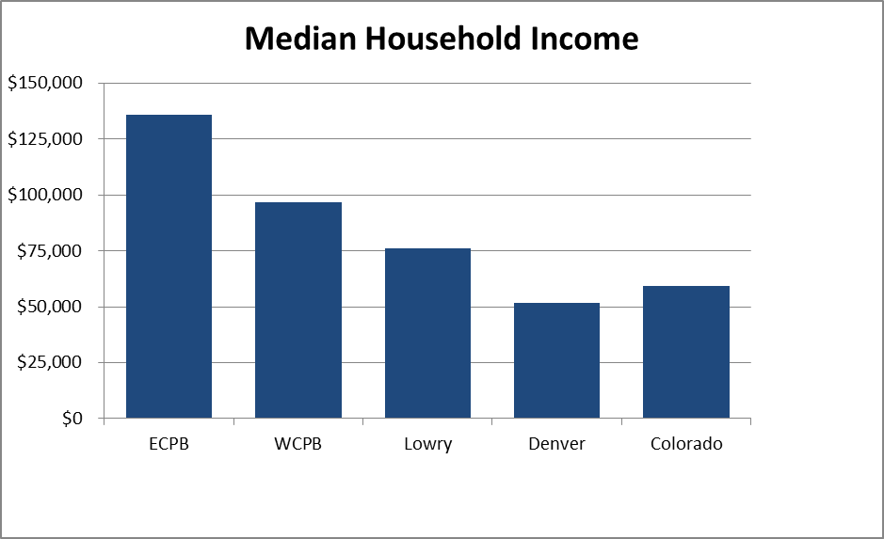
Source: ACS 2010-14

Slide 12
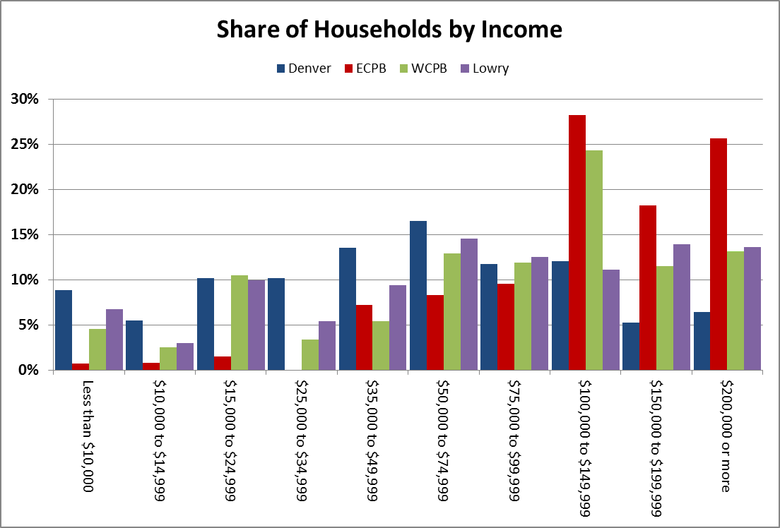
Source: ACS 2010-14

Slide 13
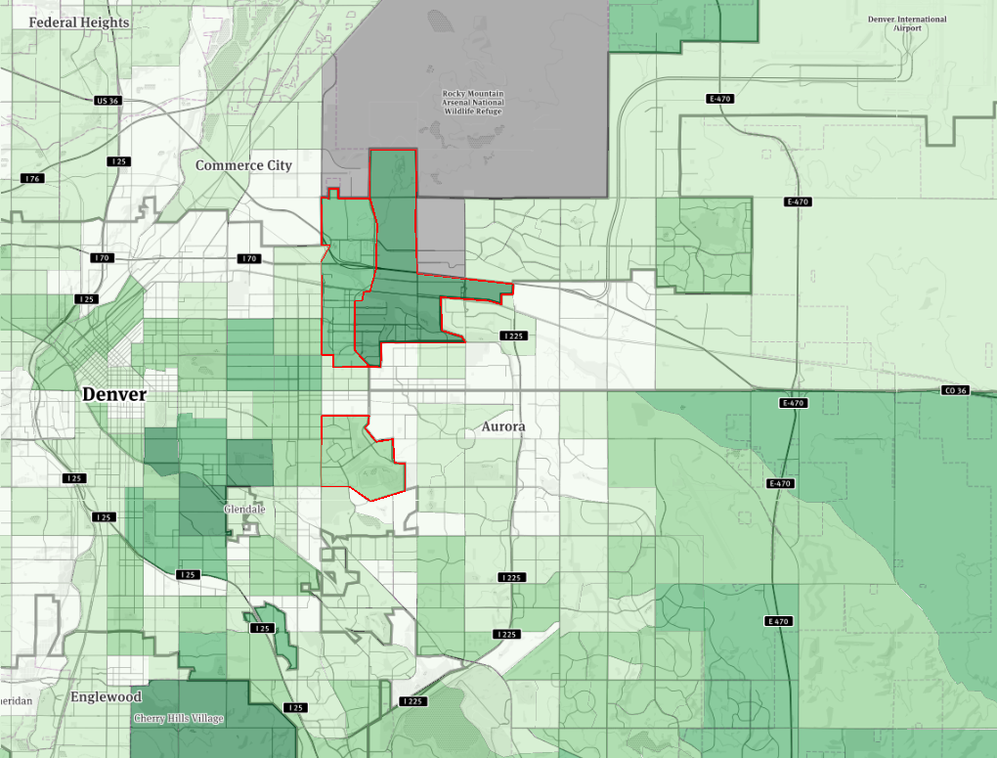
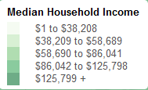
Source: ACS 2010-14

Slide 14
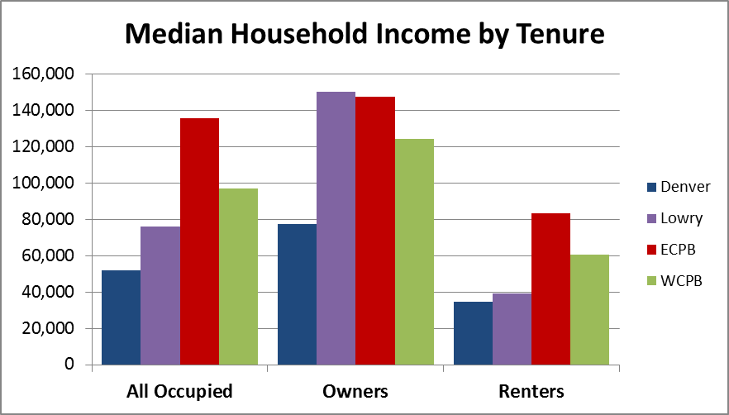
Source: ACS 2010-14

Slide 15
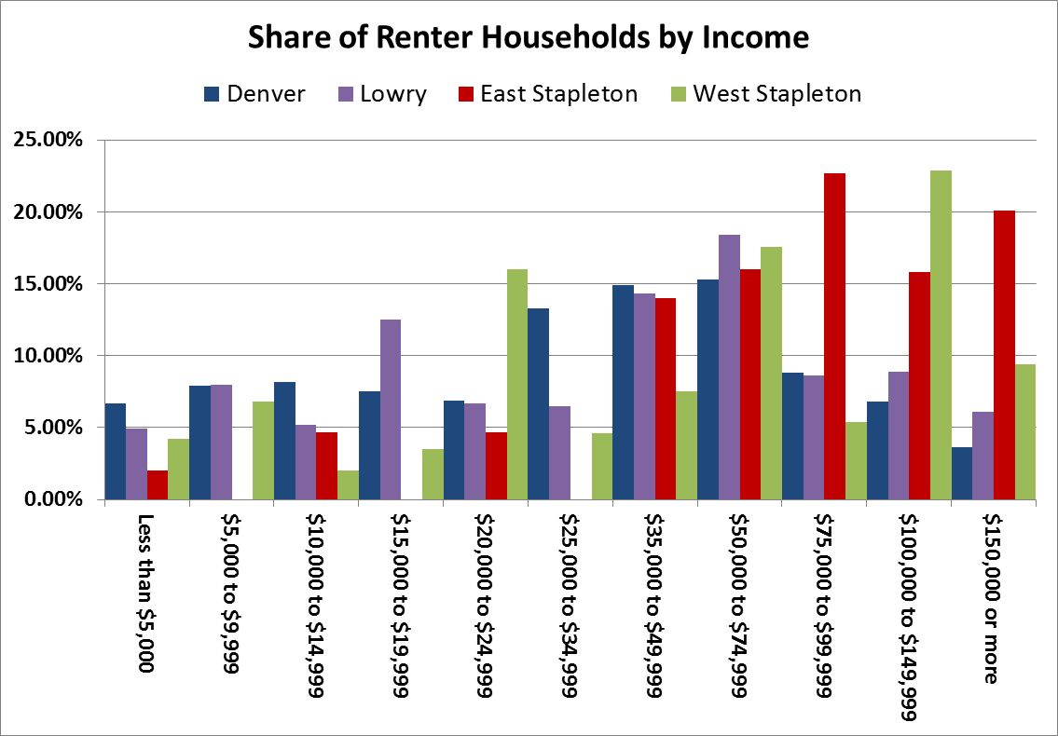
Source: ACS 2010-14

Slide 16
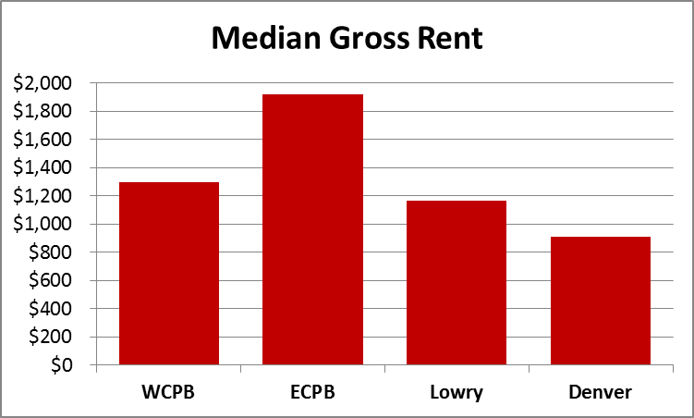
Source: ACS 2010-14

Slide 17
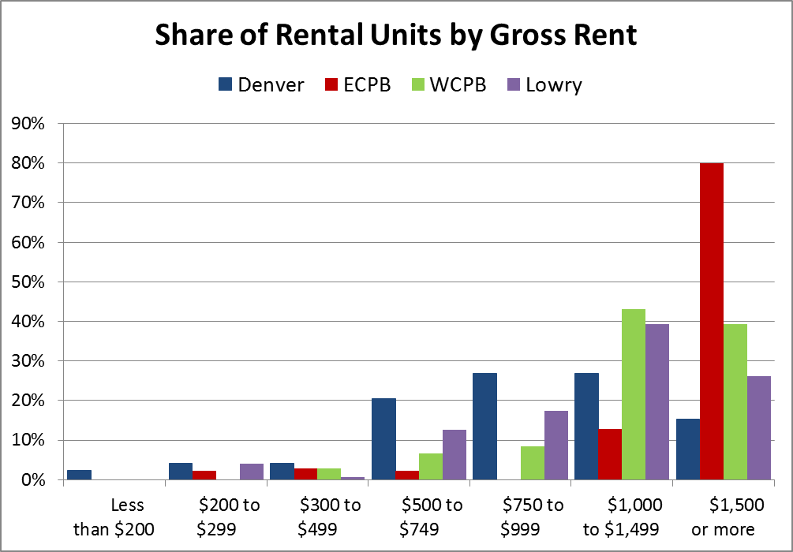
Source: ACS 2010-14

Slide 18
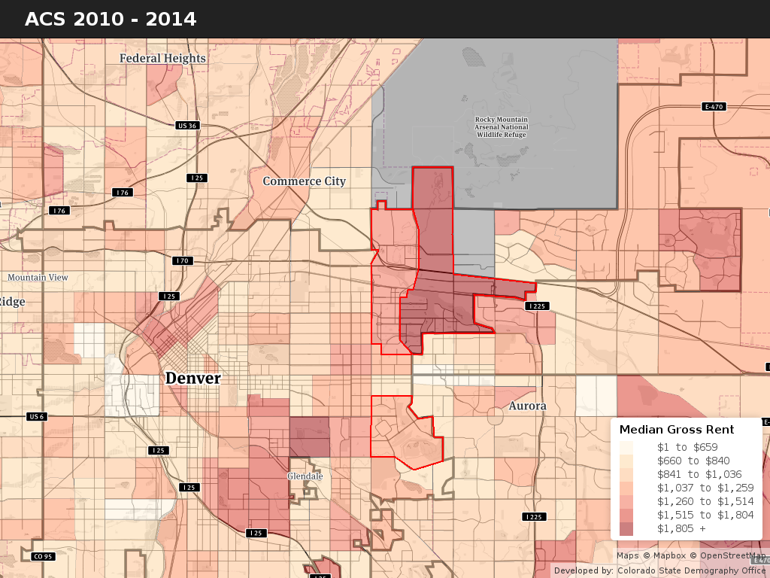

Slide 19
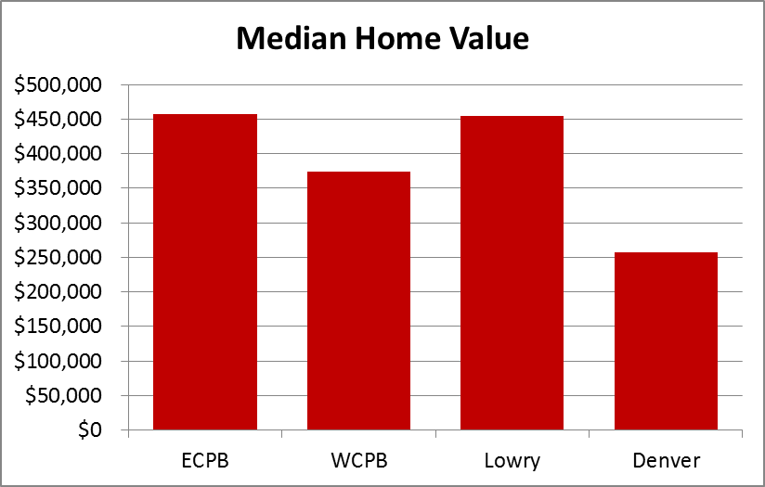
Source: ACS 2010-14

Slide 20
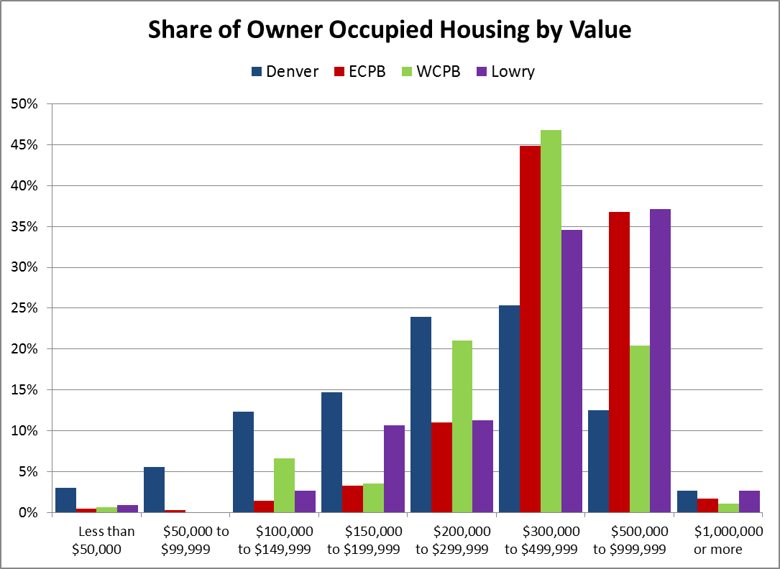
Source: ACS 2010-14

Slide 21
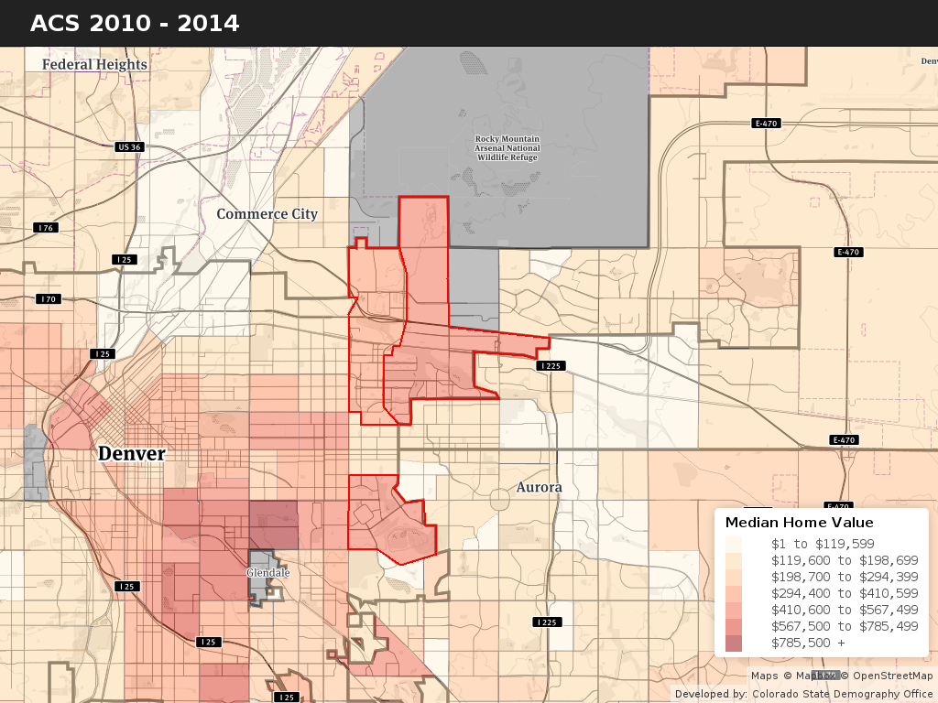

Slide 22
Tract 41.06

Slide 23
Source: ACS 2010-14

Slide 24
Questions
Contact Info
State Demography Office, Dept of Local Affairs
Elizabeth Garner
Elizabeth.garner@state.co.us
303-864-7750
Colorado.gov/demography

